Slide 1
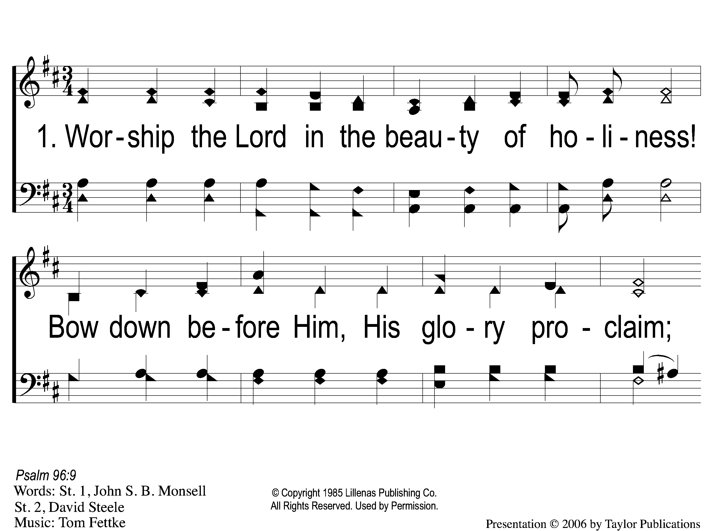
1-1 Adoration
Adoration
154

Slide 2
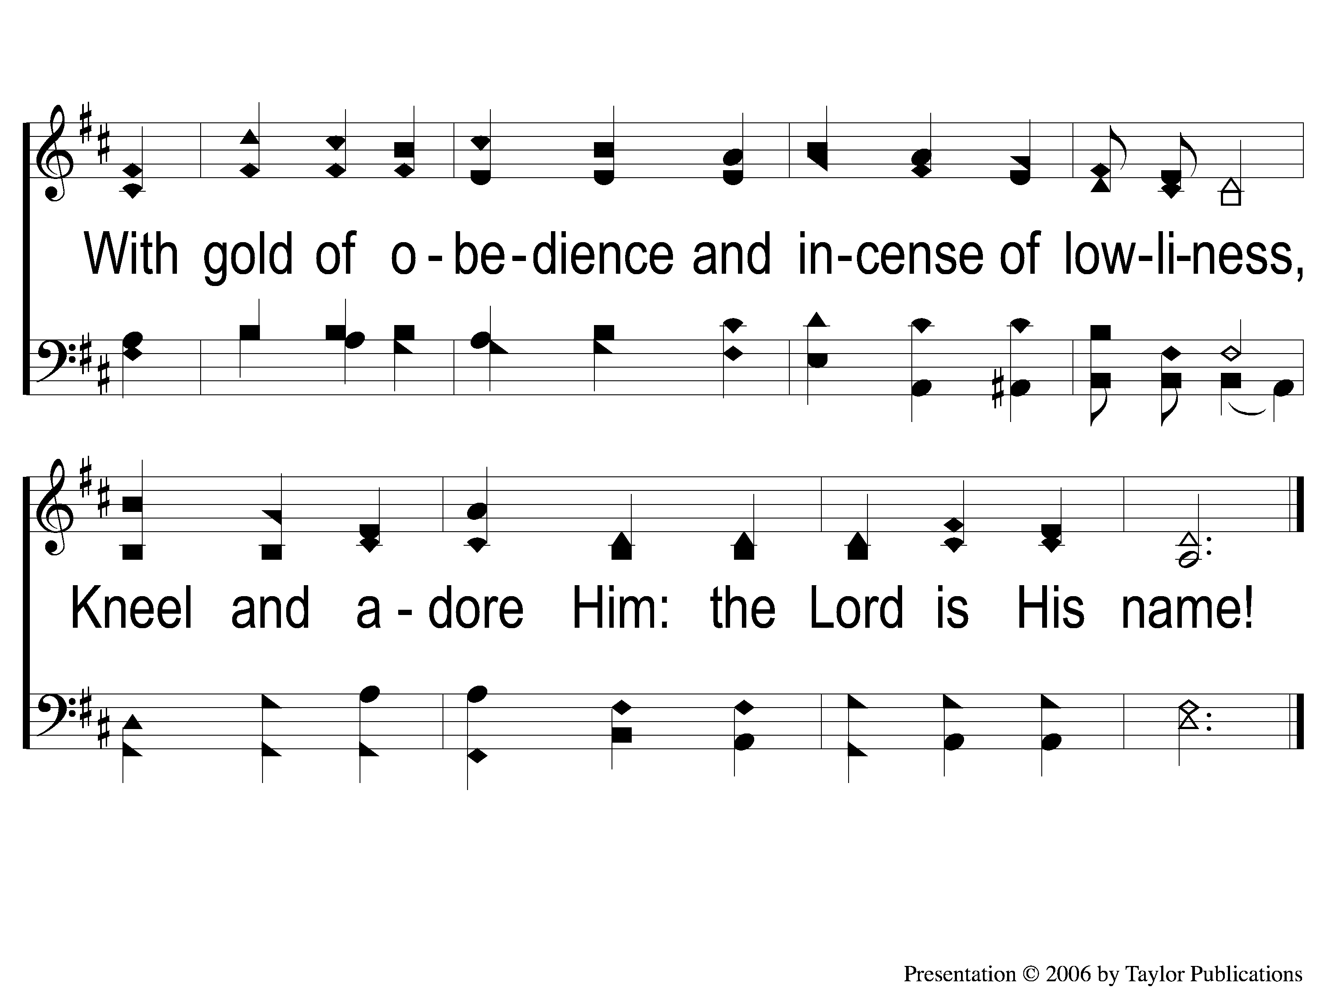
1-2 Adoration
Adoration
154

Slide 3
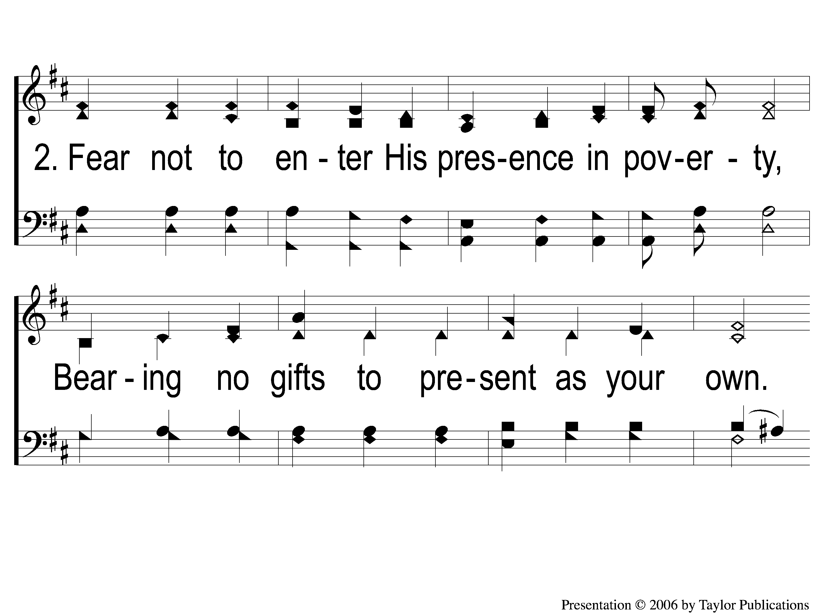
2-1 Adoration
Adoration
154

Slide 4
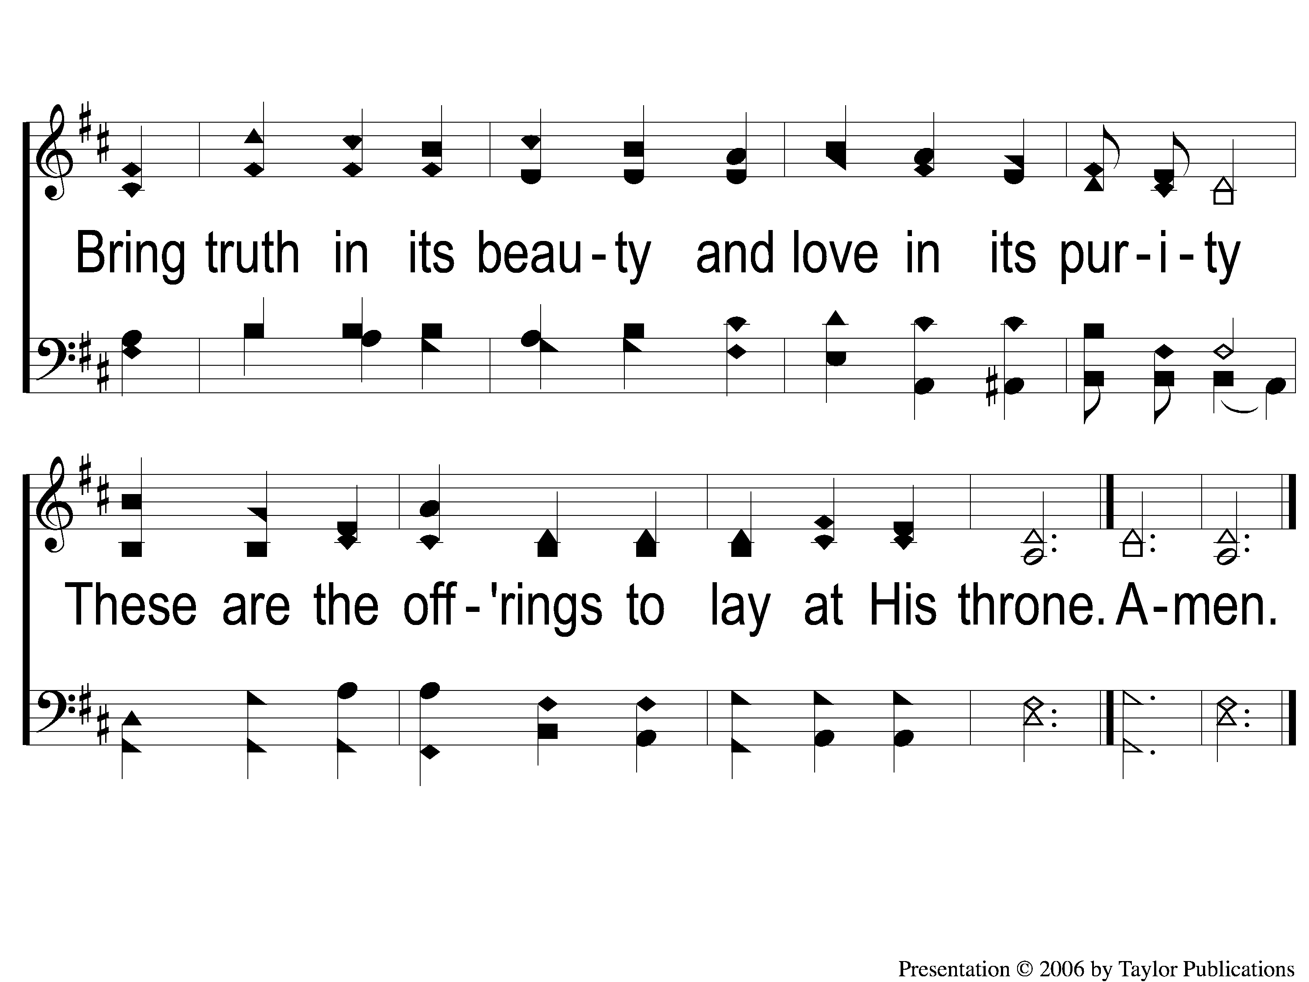
2-2 Adoration
Adoration
154

